Slide 1
Extensions to Multiple Regression
SSI II
February 22, 2018

Slide 2
Previously
Multiple regression
Dummy and categorical variables

Slide 3
Essential Questions
How can we use categorical variables properly in a multivariate regression?
What happens if we think that two variables have more than an additive effect?

Slide 4
Categorical Variables as IVs

Slide 5
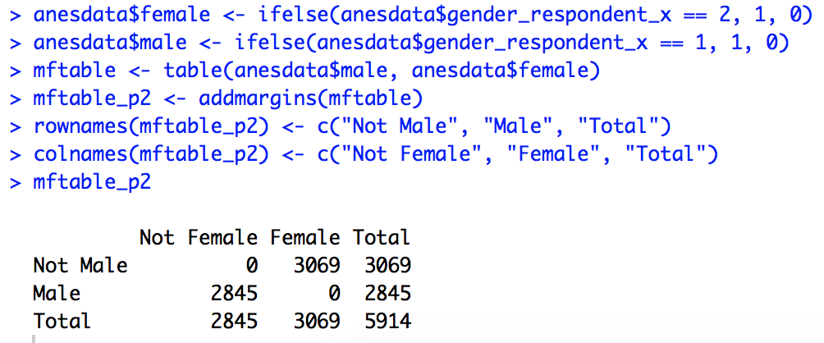
Example
DV – Hillary Clinton Thermometer
IV – Gender
Gender was ‘1’ for male, ‘2’ for female in NES data
Can make a variable ‘female’, with ‘1’ for female and ‘0’ for male
We could also make a variable ‘male’, with ‘1’ for male and ‘0’ for female

Slide 6
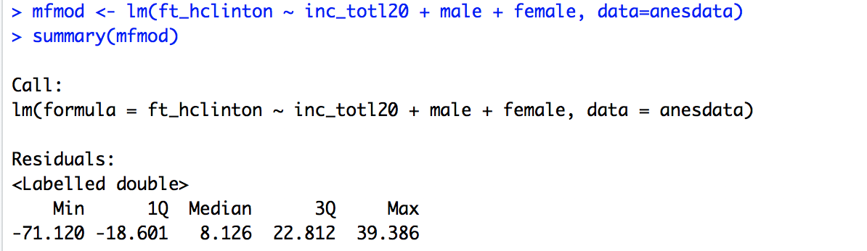
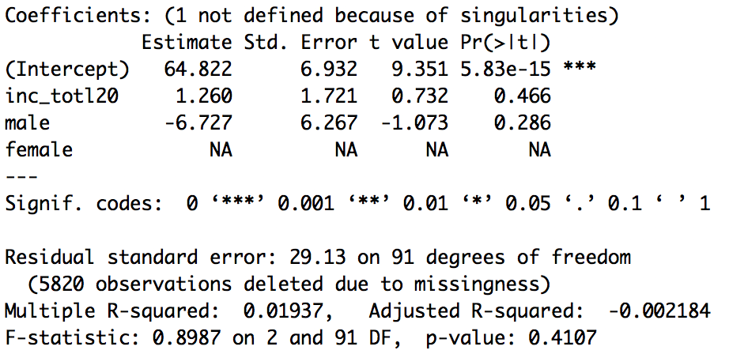
The Problem
If you try to run this model in R:
You get something like this:

Slide 7
Why?
In multivariate regression, there is the additional rule that there cannot be perfect multicollinearity between multiple variables
We can perfectly predict the values of male from the values of female and vice versa
The “dummy trap”
These are essentially the exact same variable
We have to omit one of these

Slide 8
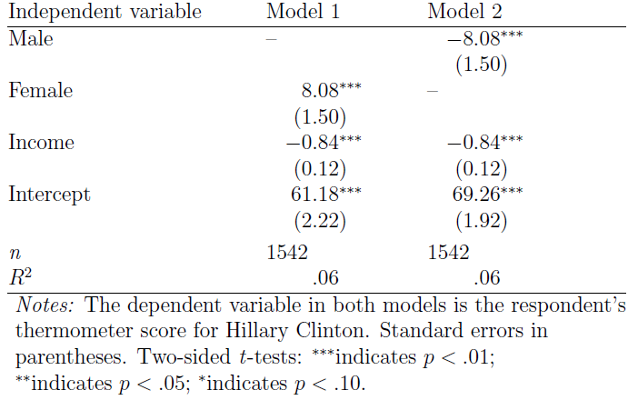
Hillary Thermometer Models

Slide 9
Hillary Thermometer Model

Slide 10
Dummy Interpretation
“On average, women will rate Hillary Clinton 8.08 points higher than men, holding income constant.”
“On average, if men had $0 of income, they would rate Hillary Clinton at a 61.18 out of 100.”
“On average, if women had $0 of income, they would rate Hillary Clinton at 69.26 out of 100.”

Slide 11
Categorical Variables
Categorical variables cannot be ordered
“On average, a one unit increase in X, leads to a β change in Y”
This does not mean anything if a categorical variable cannot “increase”
So we have to split them into a series of dummy variables
Remember we cannot include all of them
You have to leave one as a ‘reference category’

Slide 12
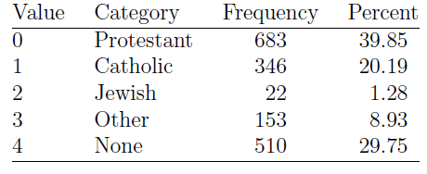
Religion

Slide 13

Hillary Thermometer Example
We include a variable for each religion, except for ‘None’, which is our reference category
How do we interpret these?

Slide 14
Interpreting These
On average, Protestants will tend to rate Hillary Clinton β₂ points higher/lower than non-religious individuals, all other variables held constant
On average, Catholics will tend to rate Hillary Clinton β3 points higher/lower than non-religious individuals, all other variables held constant

Slide 15
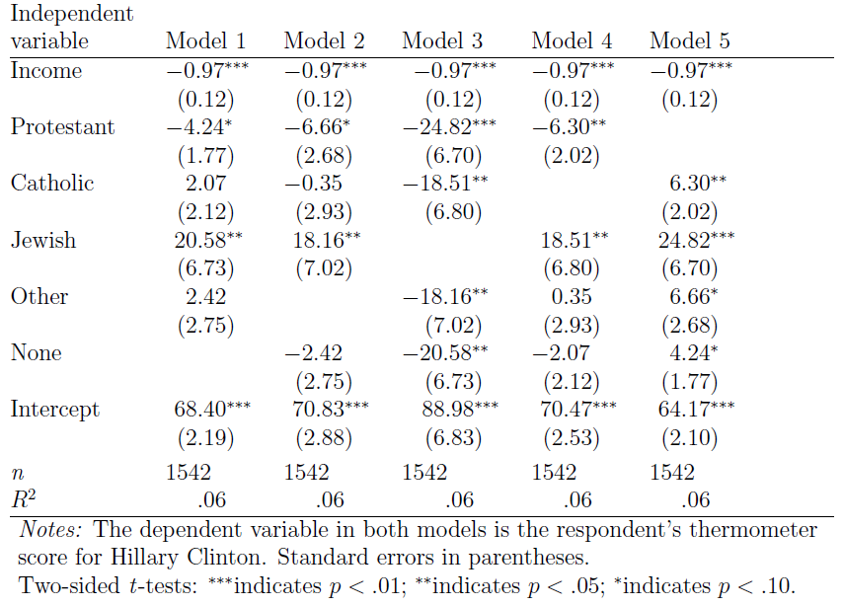
Using Different Reference Categories

Slide 16
Multiple Dummy Variables
This works the same way
You just hold the other dummy variables constant, just as you hold continuous variables constant

Slide 17
Interactive Models

Slide 18
Interactive Hypotheses
So far, we have looked at ‘additive’ models
In interactive models, we hypothesize that the effect of one IV on our DV may be contingent on the value of another IV
Maybe feelings toward the women’s movement have a stronger effect on feelings toward Hillary Clinton among women than men
Hypothesizing that the slope is steeper for women than men

Slide 19

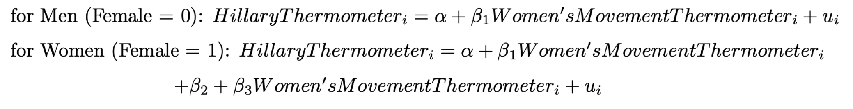
Interactive Hypotheses
We create a new variable that is the product of these two independent variables:
We have essentially created two different models for women and men

Slide 20

Interactive Hypotheses
For women, the formula also becomes:
So for women:
HillaryThermometer=(1.56+15.21)+(.75-.13)(Women’sMovementThermometer)+u
HillaryThermometer=16.77+.62Women’sMovementThermometer+u

Slide 21
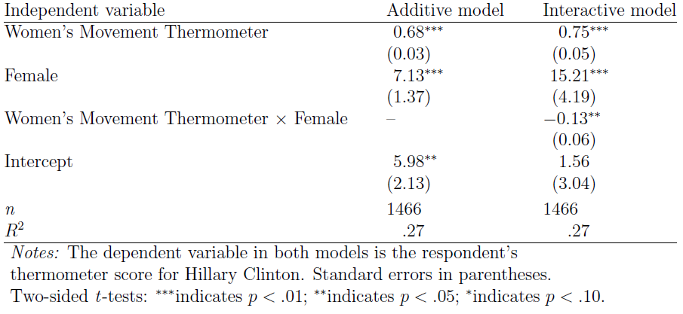
Hillary Thermometer Model

Slide 22
Hillary Thermometer Model

Slide 23
Interpretation
“When men rate the women’s movement at a 0, we predict that they will rate Hillary Clinton at a 1.56.”
“When women rate the women’s movement at a 0, we expect that they will rate Hillary Clinton at a 16.77.”

Slide 24
Interpretation
“On average, a one-unit increase in the rating of the women’s movement among women will lead to a .62 increase in one’s rating for Hillary Clinton.”
“We expect that a one-unit increase in the rating of the women’s movement among men will lead to a .75 increase in one’s rating for Hillary Clinton.”

Slide 25
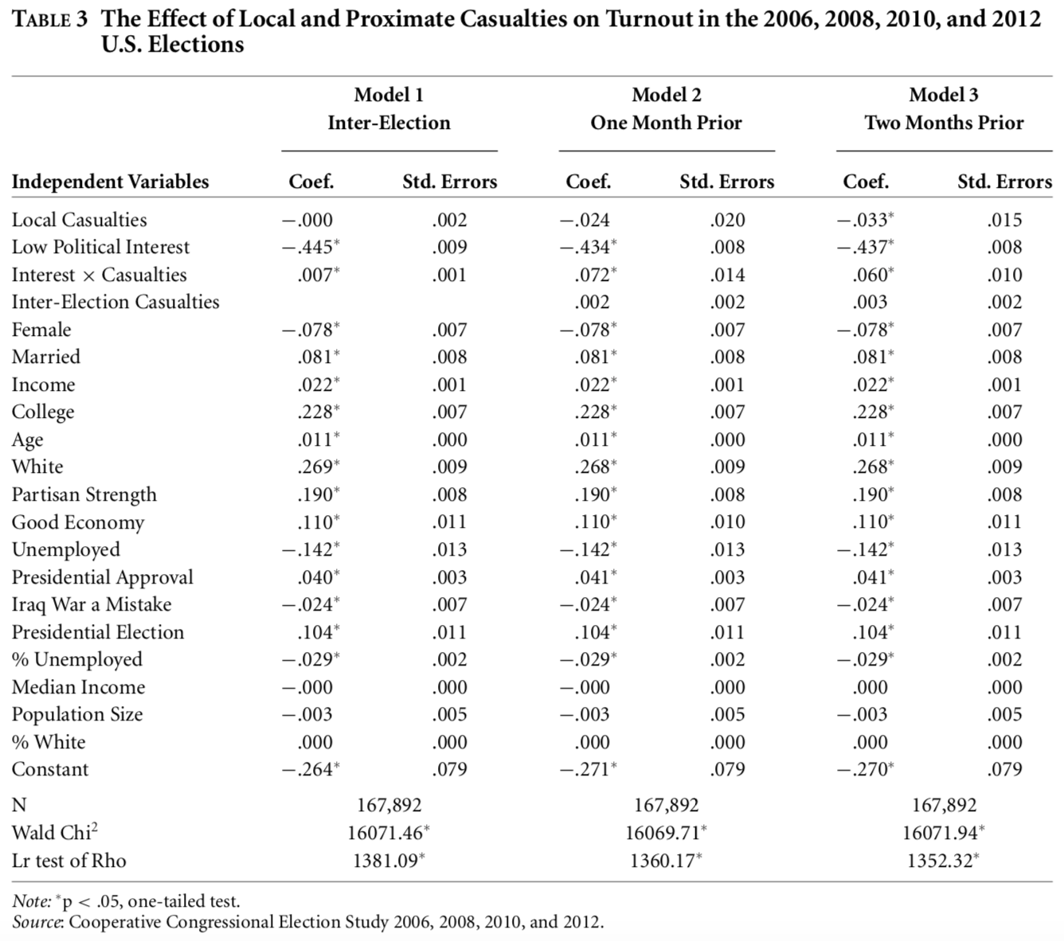
Koch & Nicholson 2015

Slide 26
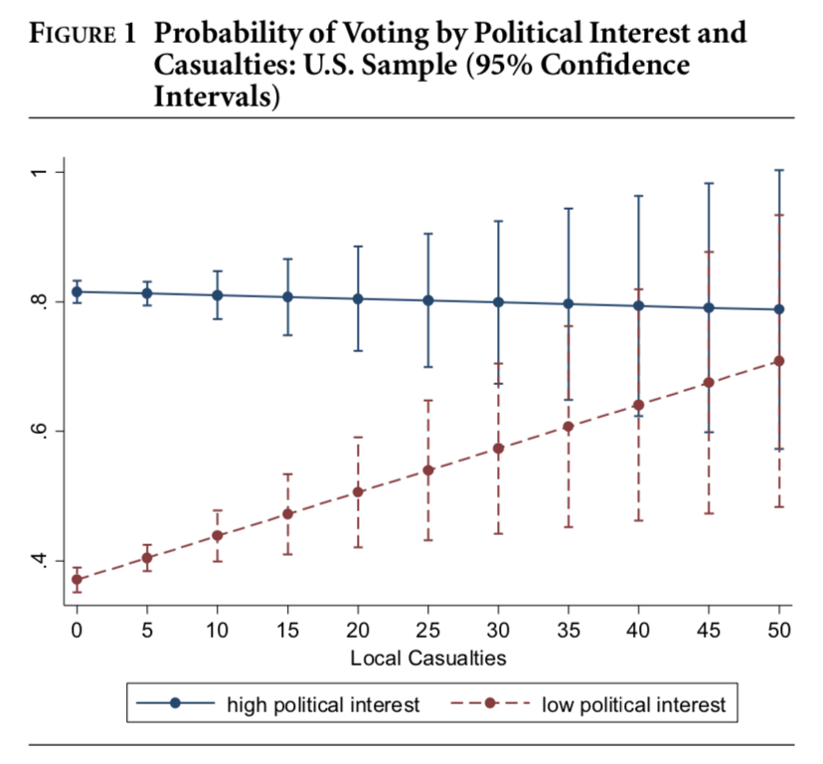
Koch & Nicholson (2015)

Slide 27
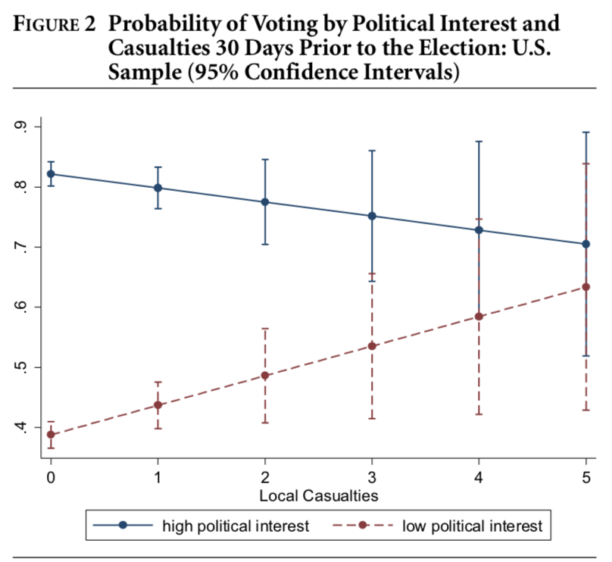
Koch & Nicholson (2015)

Slide 28
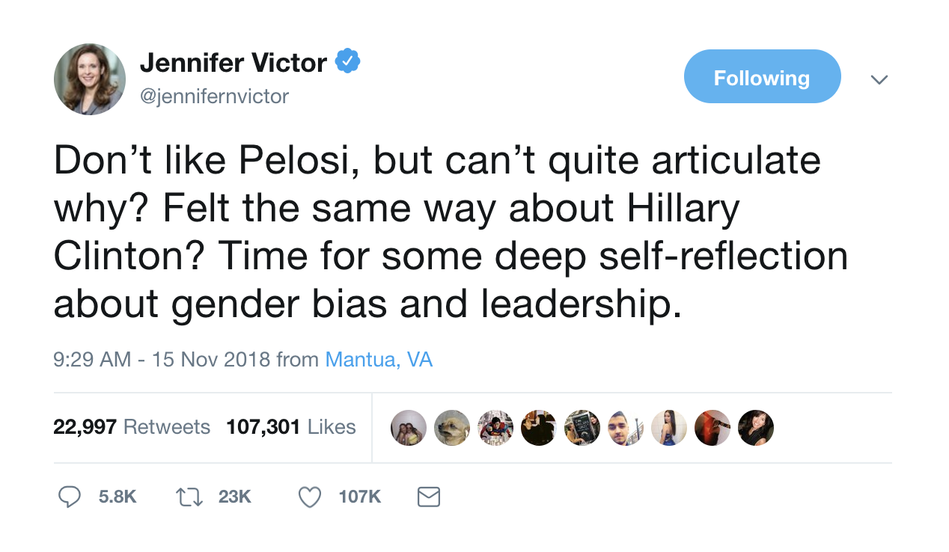
Perceptions of Clinton and Pelosi

Slide 29
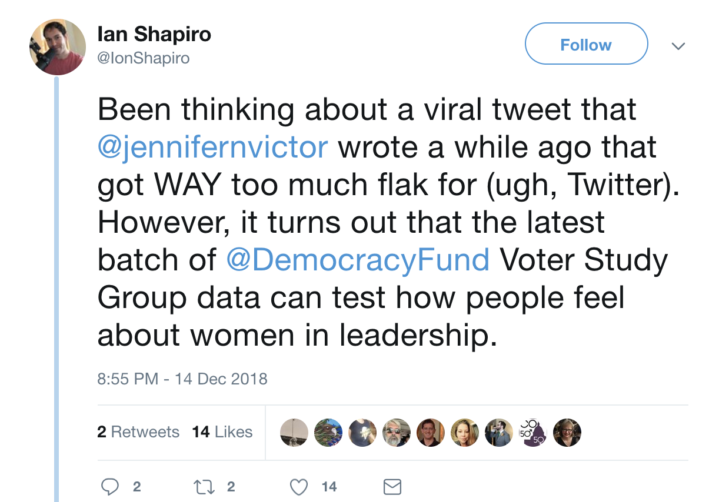
Perceptions of Clinton and Pelosi

Slide 30
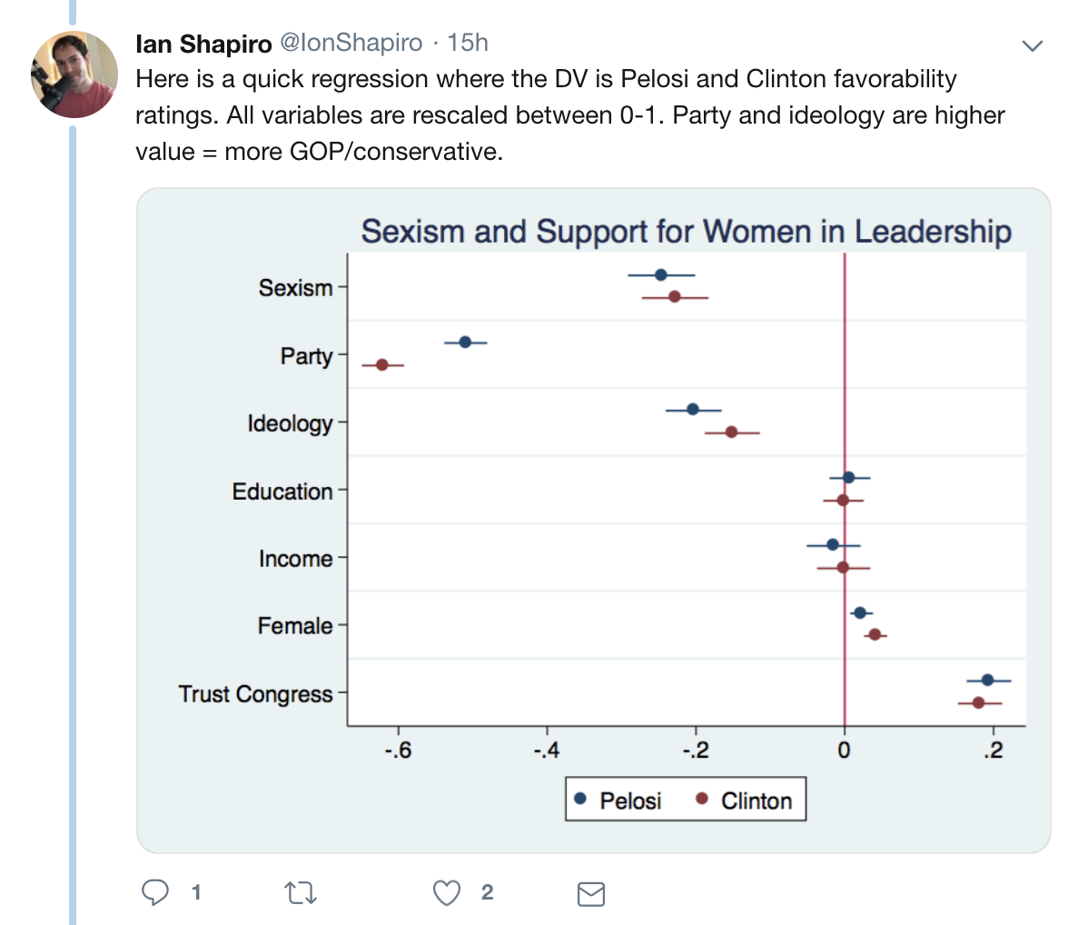
Perceptions of Clinton and Pelosi

Slide 31
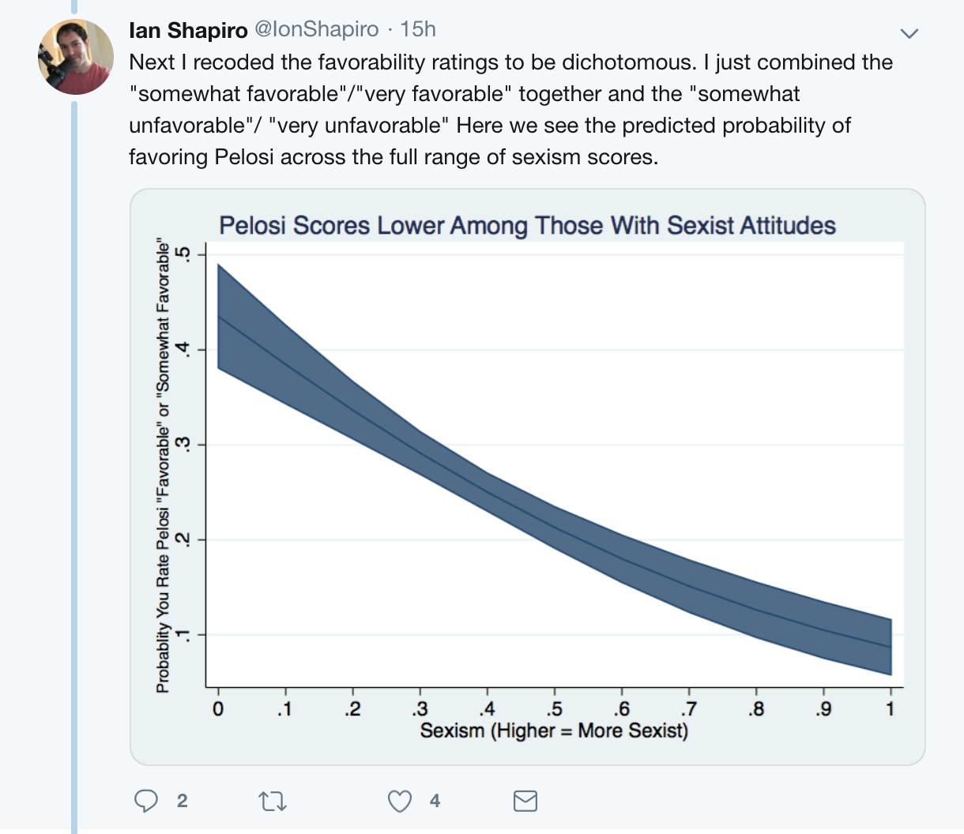
Perceptions of Clinton and Pelosi

Slide 32
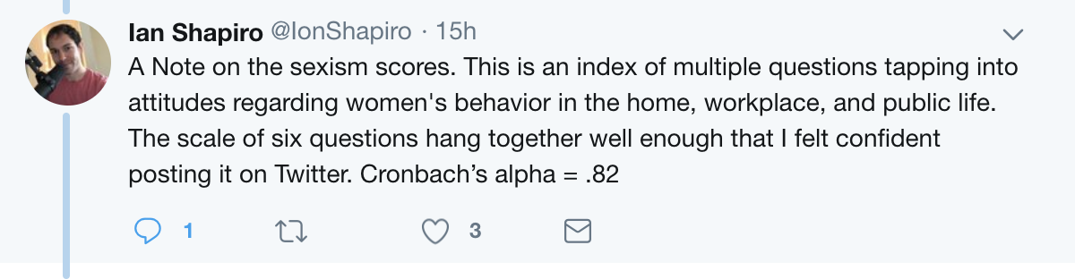
Perceptions of Clinton and Pelosi

Slide 33
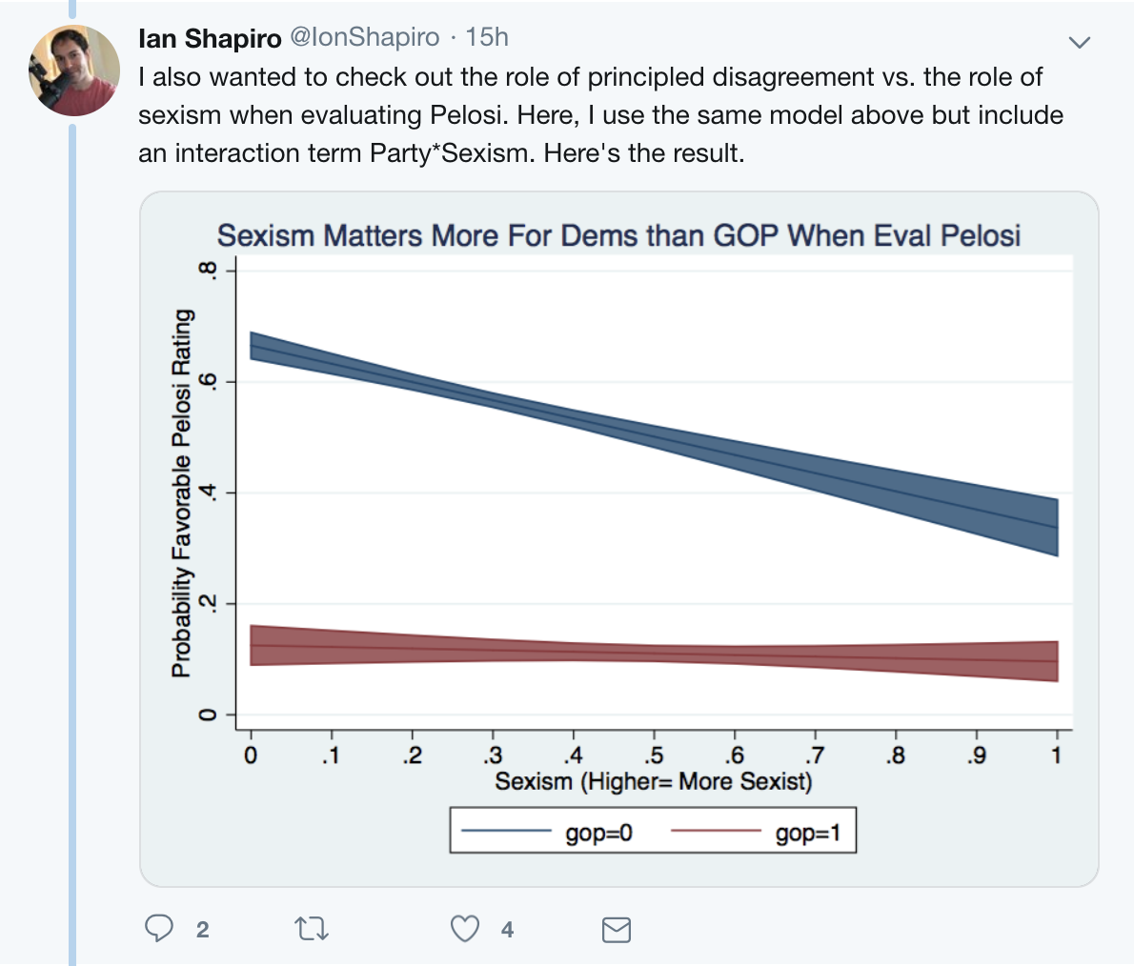
Perceptions of Clinton and Pelosi

Slide 34
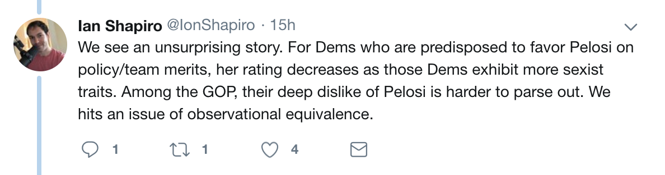
Perceptions of Clinton and Pelosi

Slide 35
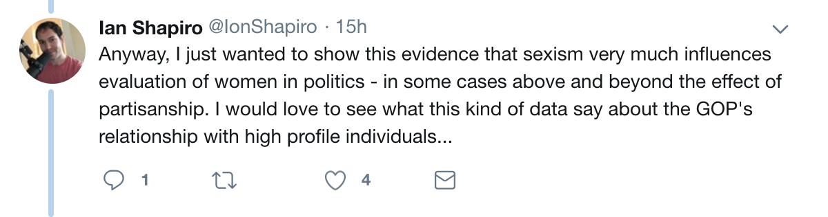
Perceptions of Clinton and Pelosi

Slide 36
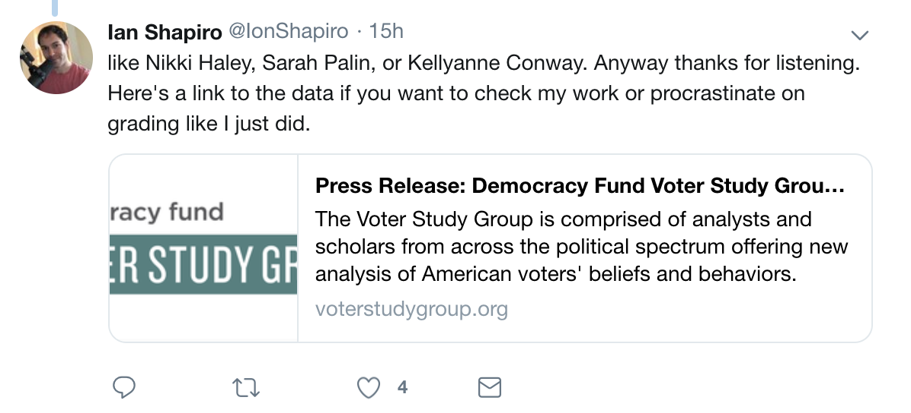
Perceptions of Clinton and Pelosi

Slide 37
Essential Questions
How can we use dummy variables properly in a multivariate regression?
What happens if we think that two variables have more than an additive effect?

